Slide 1
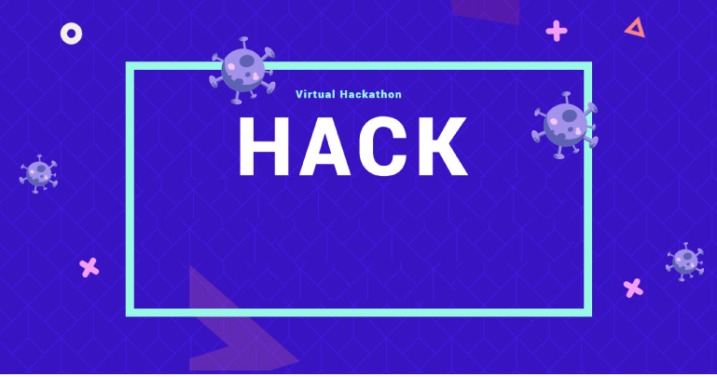
Azure Kubernetes Service HACKATHON
WELCOME

Slide 2
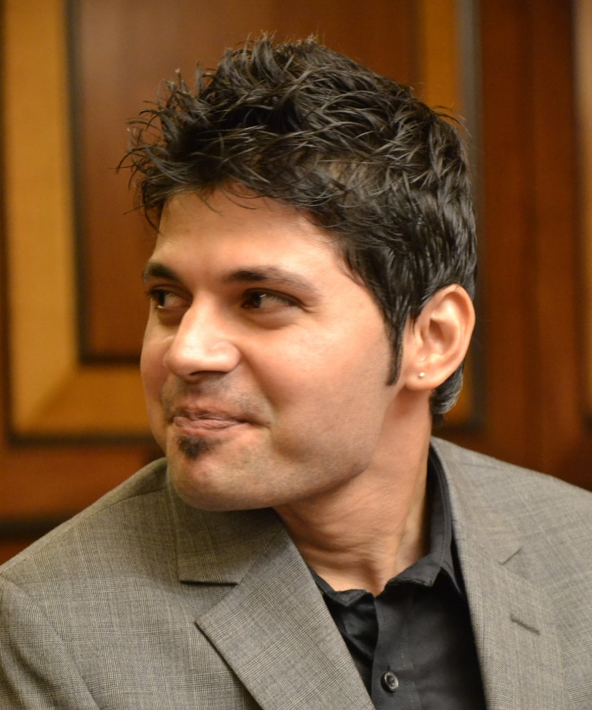
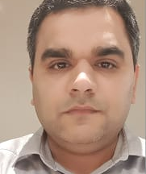
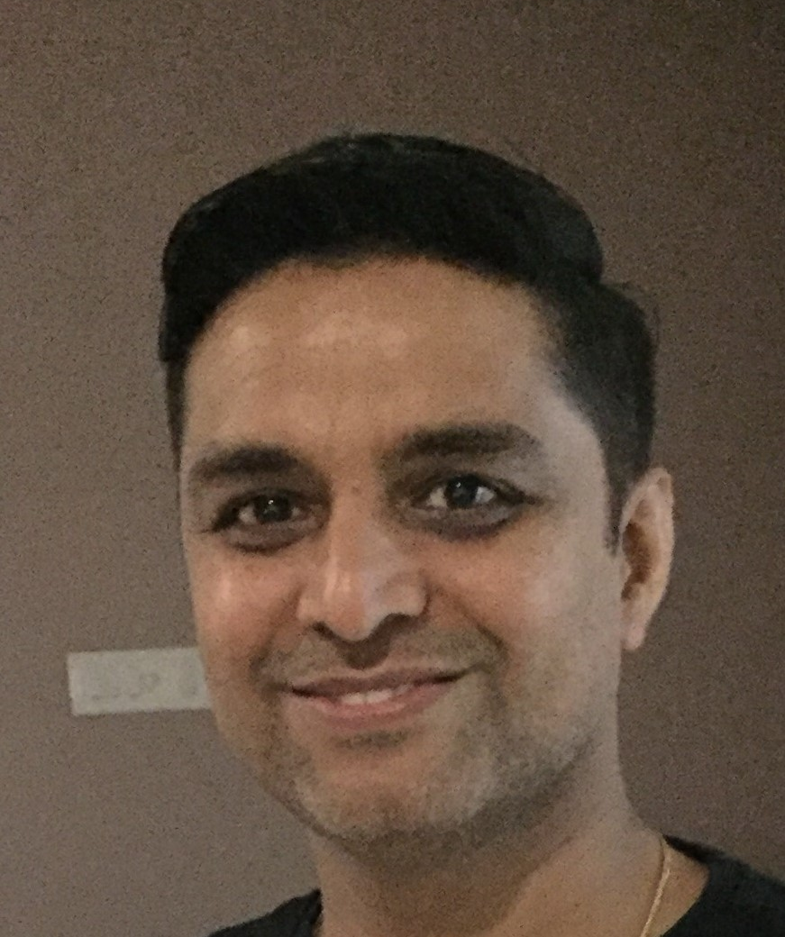
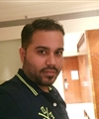
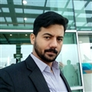
HACK PROCTORS
Saurabh Vartak – CSA
Vijay Jethani – CSA
Sumit Kute – CSA-P
Vidhyadhar Pandit - CSA
Shiva Tomar - CSA

Slide 3


Hackathon Kickoff
WORK AS A TEAM
Source: https://www.outlife.in/uploads/6/1/9/7/6197204/839049869.png

Slide 4
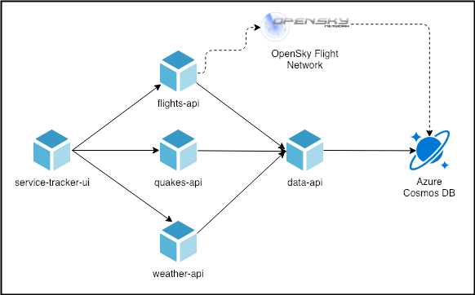
Use Case for the Hack

Slide 5

Hackathon Kickoff
6 Objectives
Bonus
Day 1
Run Locally
Deploy to Azure Kubernetes Services
App Gateway
Use Helm Deploy
Day 2
CI/CD Automation
using Azure DevOps
Network & Security
Monitoring & Logging
Setup HPA

Slide 6
Pre-requisites
Microsoft Azure Subscription
VS Code
Azure DevOps Subscription
Azure CLI
Docker Desktop

Slide 7
Hackathon Guidelines
Each team will be assigned a proctor.
Once you complete an objective please review it with the proctor. On approval by the proctor you can move to the next objective.
You must complete a minimum of 3 objectives in a day.
You are free to use tools which you are comfortable working with.

Slide 8

Objective 1: Run Locally
The source code is available at the GitHub location here
Run the solution locally using docker-compose
Use of MongoDB container for local DB deployment
Source https://cdn.onlinewebfonts.com/svg/img_175952.png

Slide 9

Objective 2: Deploy to Azure Kubernetes Services
Create Azure Kubernetes Cluster
Use Advanced Networking and choose Network Policy as Azure
Create a separate namespace “hackTEAMNAME”
Create Application Insights Instance
Create Cosmos DB
Ensure that the credentials of CosmosDB & the Application
Insights Instrumentation Key are stored as AKS Secrets
Configure ACR integration with AKS
Create docker image using ACR Tasks
Try to use ACR for building the images – reference
Create Deployment & Services manifest files for all services
Expose the service-tracker ui on Public IP, rest on Private IP’s
Mostly use YAML

Slide 10


App Gateway + Helm Deploy (Bonus)
Deploy behind App Gateway
+
Install helm 3.x
Create helm chart for these services
Deploy helm chart with CLI
Try to use YAML as far as possible
https://docs.microsoft.com/en-us/azure/container-registry/container-registry-quickstart-task-cli

Slide 11
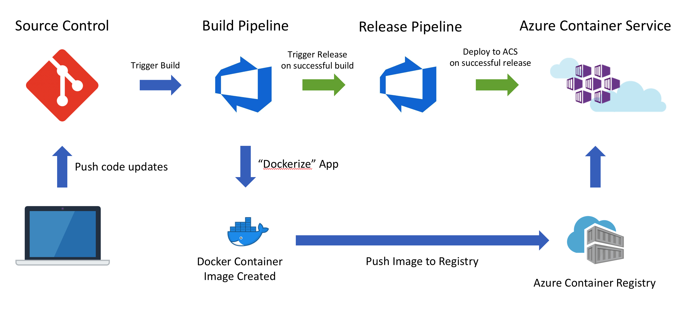
CI/CD Deployment
Check-in all your code into Azure Repo
Ensure you build & deploy your containers using Azure DevOps

Slide 12
Network & Security
Create Private Ingress Controller behind App Gateway
Network Policy to allow only flight, quakes & weather API to call data API

Slide 13
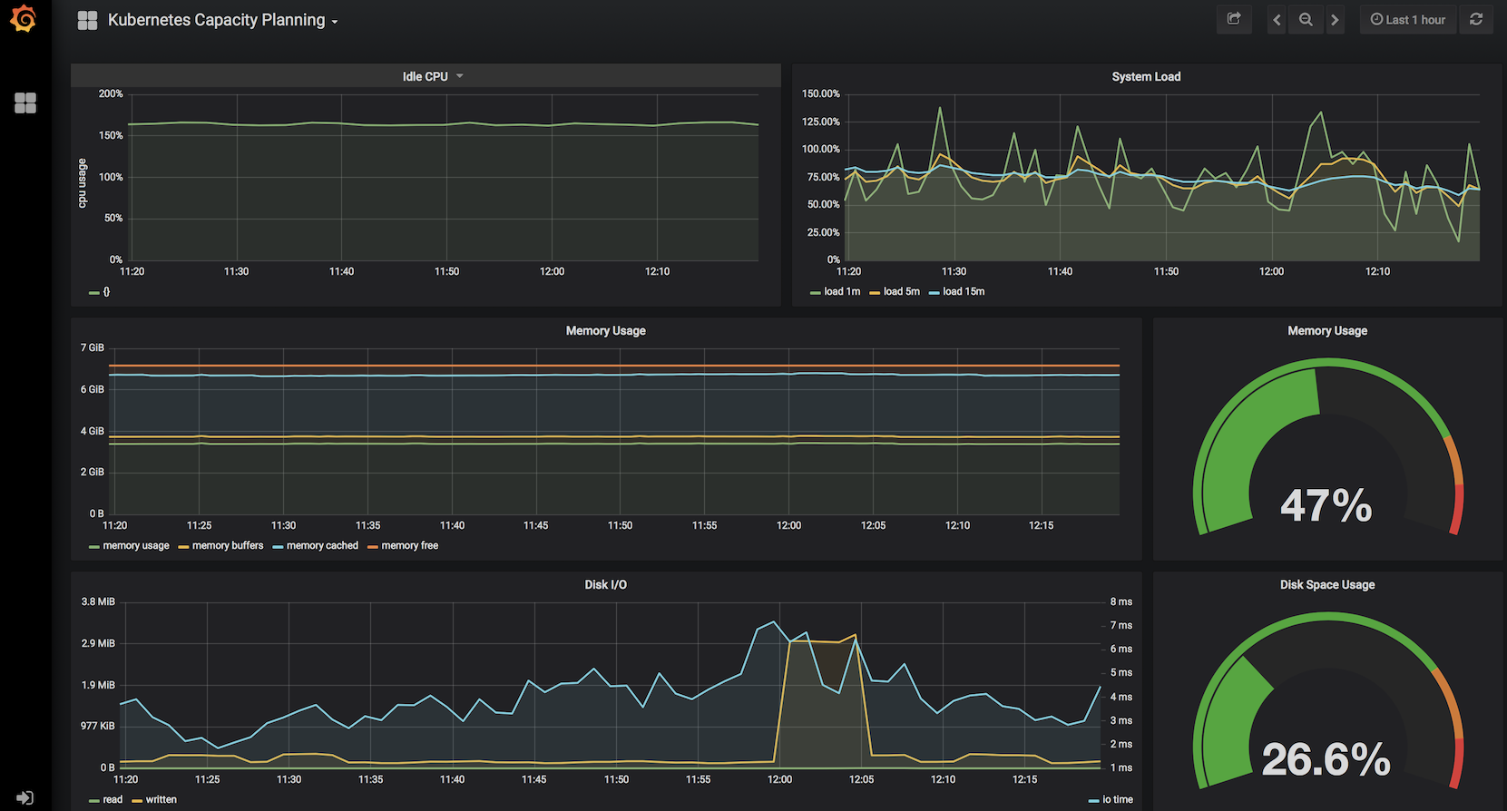
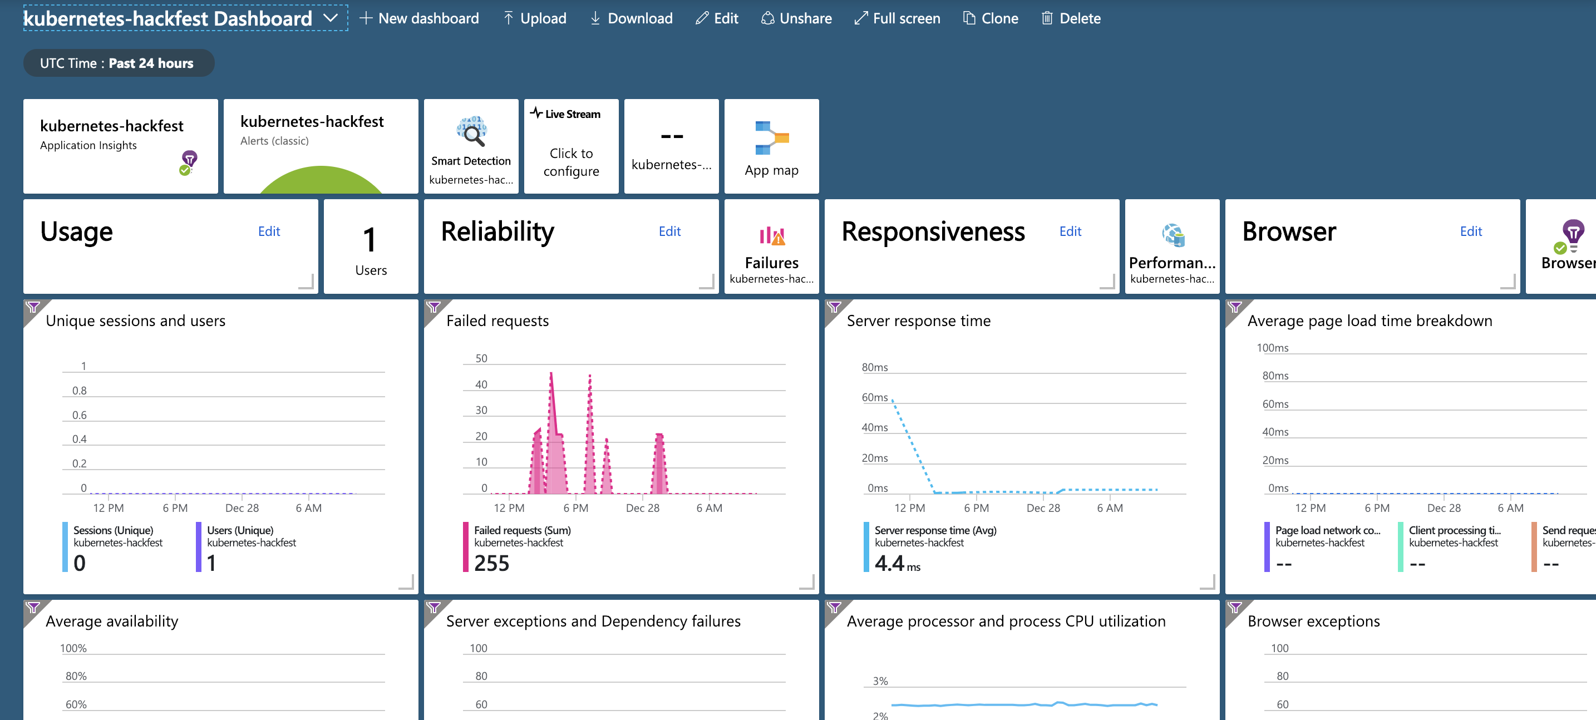
Enable Monitoring & Logging
Enable Azure Monitoring
Configure Prometheus Monitoring and expose it via Public IP

Slide 14


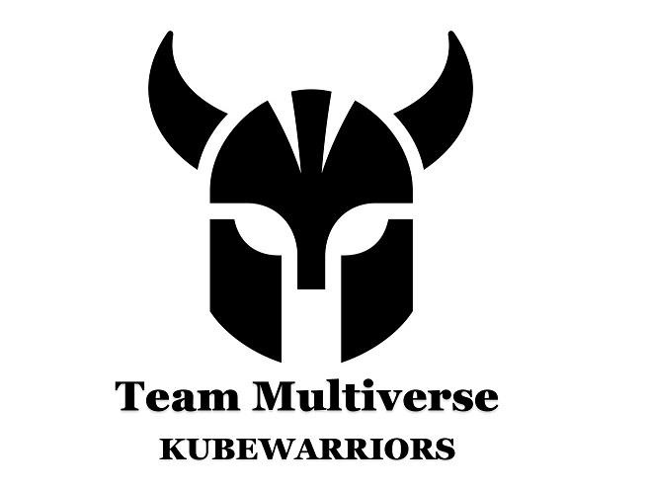
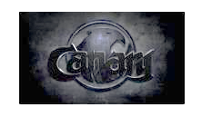
Score Card
NIIT Tech's K8s Ninja
KubeTech
NIIT Tech's AKS Army
PulseDev
KubeWarriors
SWANITES
Kubectl
Monocube
KubeMaster
CANSPARK
Objective
ANNOUNCEMENT: 1 PM - 1st Objective discussion and solution

Slide 15
NIIT Teams
Team 1 | NIIT Tech's K8s Ninja
Team Lead | Renu Teotia
Team Members | Harsh Kishor
 | Niharika Prajapati
 | Radhika Dwivedi
 | Vidhi Khurana
 | Ankita Mittal
 | Ojasvi Singh
Team- 2 | NIIT Tech's AKS Army
Team Lead | Amit Kumar
Team Members | Atindra
 | Ankita Verma
 | Shubham Mathankar
 | Tanvi Gupta
 | Rakhi Dawande
 | Meenakshi Sain

Slide 16
Multiverse - KubeWarriors
Team Multiverse - Kubewarriors
Team Lead | Deepak Parashar
Team Members | Manoj Kumar
 | Prateek Parashar
 | Sachin Gupta
 | Diwanshi Sharma

Slide 17
PWC
Kubectl
KubeMaster
Harish
Amit
Moti
Shruti
Samrudh
Ravindra
Shruti
Shivam
Uday
Ashish
Digvijay
Jayanth
Linju
Maheedhar
Nasir
Sathyam

Slide 18
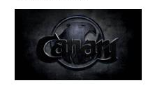
Canary - CANSPARK
Shanmukh nath reddy
Srikanth Pusarla
Siddesh Munde
Shaik Rabbani
Raparthi Kalyan

Slide 19
Monocept - Monocube
Shanthi priya
Rudra Lakshmi Phanindra
Ankur Hariram Mishtra
George John Dsouza
Badugu Ashok
Gaurav Pandey
Srinivas Sunki
Sivakumar Dhanasekaran

Slide 20
SWAN - SWANITES
Vinod Ranaveni
Jitesh Patel
Rakesh Sarak
Sandeep Potekar
Jesudas Nadar

Slide 21
Celebal - KubeTech
Ravindra Shekhawat
Anuj Upadhyay
Prateek Agarwal
Jogendra Singh
Upendra Jangir

Slide 22
PC Solution - PulseDev
Sandeep Kunar
Vinay Sharma
Abhay Singh
Swarnadeep

